Slide 1
HCOM Analytics Insights Case Study
Drivers of Net Room Nights & Key Recommendations
Presented by: [Lalit Anand]

Slide 2
Objective
Analyze drivers of Net Room Nights
Identify marketing, platform, region, and seasonal trends
Recommend actions based on data insights

Slide 3
Data Overview
Simulated CSV dataset provided
Metrics: Visits, Qualified Shoppers, Net Orders, Net Room Nights
Dimensions: Date, Geographic Region, Platform, Marketing Channel

Slide 4
Key Metric Definitions
Metric | Definition
Visits | Total site visits
Qualified Shoppers | Visits with search or property detail viewed
Net Orders | Orders after cancellations
Net Room Nights | Room nights booked minus cancellations
Shopper Conversion Rate | Percentage of visitors who become qualified shoppers.
Booking Conversion Rate | Percentage of qualified shoppers who complete a booking.
Traffic Efficiency | Average number of Room nights booked in a single hotel visit on platform.
Room Nights per Order | Average number of Room nights booked in a single hotel booking.
Bounce Rate | Percentage of Visitors who bounced from platform.

Slide 5
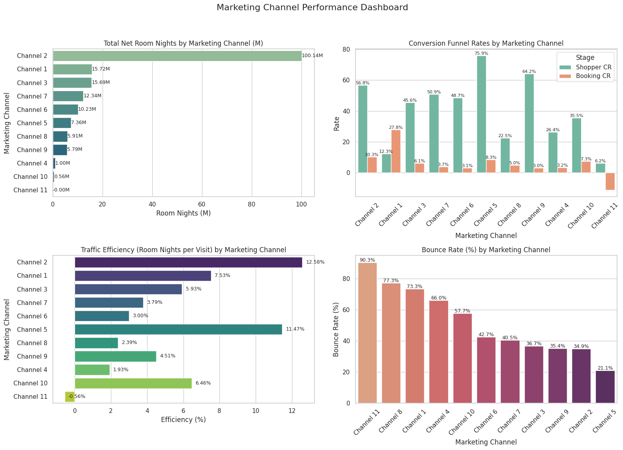
Charts

Slide 6
Marketing Channel Analysis
1. Channel Volume & Impact
Channel 2 leads by volume with 100M+ room nights, making it our core revenue driver.
Channels 1, 3, 6, and 7 contribute moderately with 6-15M room nights.
Channels 10 and 11 have minimal impact and warrant further investigation.
2. Shopper Quality & Engagement
Channels 5, 9, and 2 excel in attracting highly engaged visitors with shopper conversion rates above 60%.
Channels 1 and 11 lag significantly on shopper engagement, indicating low-quality traffic or UX challenges.
3. Conversion Effectiveness
Channel 1 converts shoppers to bookings most effectively with a 28% booking conversion rate, despite lower shopper quality.
Channels 5, 2, and 10 also show solid booking conversion in the 7-10% range.
Negative booking conversion in Channel 11 signals data or operational issues requiring urgent review.
4. Efficiency of Traffic
Channels 2 and 5 are most efficient, generating more room nights per visit (above 11%).
Channels with low efficiency, such as 4, 7, and 8, could benefit from improved targeting or UX enhancements.
Channel 11’s notably negative room nights per visit suggests shorter stays or cancellations.
5. Bounce Rate
Channel 11 has the worst bounce rate (90.3%), followed by Channels 8, 1, and 4, all above 65% — suggesting poor landing pages or irrelevant traffic.
Channel 5 has the lowest bounce rate (21.1%), aligning with its high efficiency and strong funnel metrics.

Slide 7
Recommendation on Marketing Channel
Prioritize marketing spend on Channels 2 and 1 for volume and conversion strength.
Investigate Channel 11’s data and operations to identify and resolve performance gaps.
Enhance user experience and targeting on low shopper conversion channels (1, 10, 11).
Leverage high-efficiency channels (5, 9) to maximize ROI by scaling successful tactics.
Conduct deeper qualitative analysis to understand visitor behaviour differences across channels.

Slide 8
Recommendation on Marketing Channel
Channel 2 — Scale It
Why: Highest total room nights, best traffic efficiency (12.6%), low bounce rate (~35%).
Action:
Increase budget allocation — High ROI channel.
Consider expanding similar audience targeting or geographies.
Channel 5 — Invest More in Quality Traffic
Why: Highest Shopper CR (75.9%), 2nd best efficiency (11.5%), lowest bounce rate (21%).
Action:
Increase traffic volume — campaign performs well post-click.
A/B test creatives and keywords to improve initial reach.
Channel 1 — Optimize Landing Experience
Why: Strong Booking CR (27.8%), decent efficiency (7.5%), but bounce rate is high (73.3%).
Action:
Revamp landing pages — ensure they match ad intent.
Check page load time, UX issues, or misleading CTAs.
Channel 8 — Fix Bounce Issues
Why: High Shopper CR (64%), but bounce rate is 77.3% and low efficiency.
Action:
Run diagnostic tests on mobile/desktop experiences.
Consider retargeting strategies for bounced users.
Channel 11 — Pause & Investigate
Why: Zero room nights, -0.56% efficiency, worst bounce rate (90%), poor conversions.
Action:
Pause spend immediately.
Investigate if tracking is broken or if bot/spam traffic is inflating metrics.

Slide 9
Recommendation on Marketing Channel
Channel 4 & 10 — Underperformers
Why: Low room nights, high bounce rates (~66%), low efficiency (<2%).
Action:
Consider reducing spend or restructuring the campaign strategy.
Focus on audience refinement or better creatives.
Cross-Channel Strategic Recommendations
Audit Bounce Rate Drivers: High bounce often means misaligned ads, slow pages, or poor mobile UX.
Segment & Retarget Efficient Channels: Channels 5 & 2 can be used to build retargeting segments for underperformers.
Invest in Post-Click Optimization Tools: Tools like Hotjar, Google Optimize, or Crazy Egg can show where drop-offs happen.
Test for Incrementality: Especially for Channel 2 — ensure that scaling spend is driving net new conversions, not cannibalizing others.

Slide 10
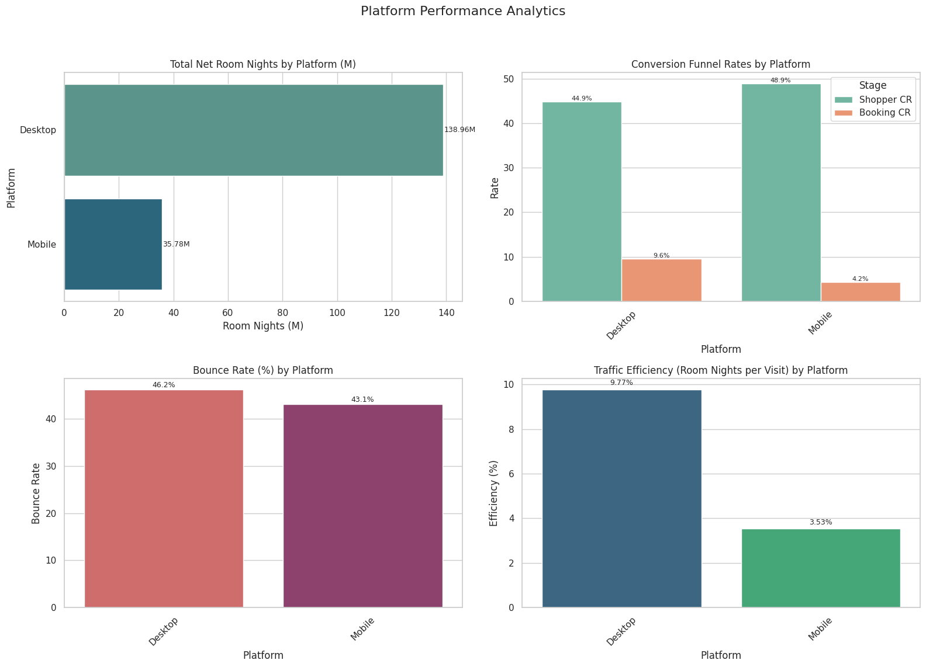
Charts

Slide 11
Platform Analysis
1. Net Room Nights Volume
Desktop generates ~139M room nights, dominating platform performance.
Mobile contributes significantly less (~36M), showing potential room for growth.
2. Conversion Funnel
Shopper Conversion Rate is slightly higher on Mobile (48.9%) than Desktop (44.9%) — mobile users are interested.
However, Booking Conversion Rate on Mobile is only 4.2%, less than half of Desktop’s 9.6% — strong intent but poor follow-through.
3. Bounce Rate
Both platforms have high bounce rates (43–46%), with Desktop slightly worse.
Indicates potential UX or content relevance issues across both.
4. Traffic Efficiency
Desktop traffic is nearly 3× more efficient (9.77%) than Mobile (3.53%) in converting visits to room nights.
Suggests better performance per visit and stronger completion behaviour on Desktop.

Slide 12
Recommendation on Platform
UX & Technical Optimization
Improve mobile booking experience: Simplify checkout, reduce load times, and ensure payment reliability.
Investigate causes of high mobile drop-off: Look for friction in mobile funnel (especially between product view and checkout).
Mobile-Specific Initiatives
Retarget mobile shoppers with personalized incentives (e.g., app-exclusive discounts or abandoned cart emails).
Consider A/B testing for mobile-friendly layouts to reduce bounce and increase booking conversion.
Channel Strategy
Focus traffic investment toward Desktop for short-term efficiency and ROI.
Invest in longer-term mobile improvement to unlock shopper potential (given strong intent).

Slide 13
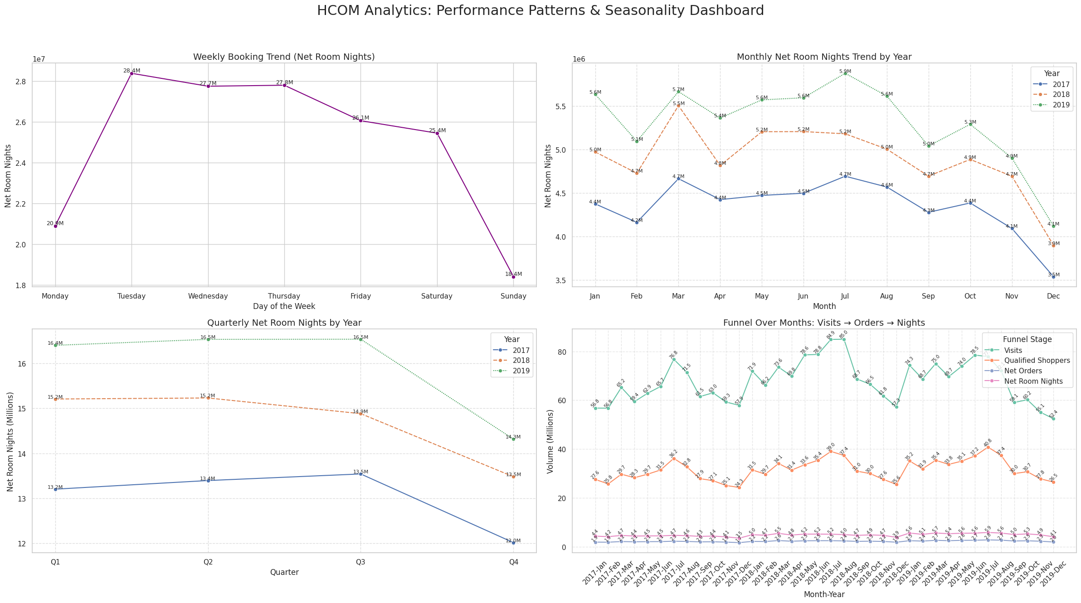
Charts

Slide 14
Patterns & Seasonality Analysis
1. Weekly Booking Trend
Peak booking days are Tuesday to Thursday, especially Tuesday (28.4M).
Lowest activity on Sunday (18.4M) and Monday, suggesting users plan mid-week.
2. Monthly Net Room Nights (2017–2019)
2019 consistently outperforms previous years.
Peaks in July (5.9M) and October (5.3M) hint at summer and Q4 seasonal demand.
December dips across all years, possibly due to holiday travel behaviour shifts.\
3. Quarterly Performance by Year
Q2 and Q3 are strongest quarters across years, particularly Q2 2019 (16.53M) and Q3 2019 (16.54M).
Noticeable decline in Q4 2019, aligning with monthly December drop.
4. Funnel Performance by month-Year
Main Funnel Drop-offs:
Biggest loss is between Qualified Shoppers → Net Orders
Suggests users show interest but don’t complete bookings
High Funnel Health:
Steady or increasing visit volume signals strong brand awareness and traffic
Consistent Bottom Funnel:
Room nights reflect order volume closely, implying booking fulfillment and hotel supply are functioning well

Slide 15
Recommendation on Seasonality
Time-Based Strategy
Promotional campaigns should be concentrated mid-week (Tue–Thu) when booking activity is highest.
Align marketing budgets and discount strategies around Q2 and Q3, especially summer travel.
Funnel Optimization
Continue investing in targeted marketing strategies that bring in high-intent users. Leverage data from top-converting campaigns to refine ad targeting, use personalized landing pages, and ensure the messaging aligns with what travellers are searching for. Audit UX/UI for conversion friction — simplify checkout, load speed, personalization.
Conduct a detailed UX audit of the booking journey. Simplify steps to book, add reassurance (e.g., cancellation policies, reviews), and highlight urgency (e.g., “Only 2 rooms left at this price!”). Also, consider A/B testing price displays and checkout flows to reduce drop-off and boost conversions.
Maintain the current strengths in operational execution. To further enhance loyalty, consider following up post-stay with incentives for repeat bookings or referrals, as well as gathering reviews to reinforce the cycle for future shoppers.
Experimentation
A/B test promotions in Q4 to reverse seasonal declines — consider bundling or early holiday deals.
Use behavioural insights to target Sunday & Monday with reminder nudges or mobile offers.
Channel Management
Invest more into Channel 2 — high-volume and efficient.
Consider retargeting Channel 1 users who browse but don’t book.
De-prioritize Channels 10 & 11 unless operational fixes or segment refinements are introduced.

Slide 16
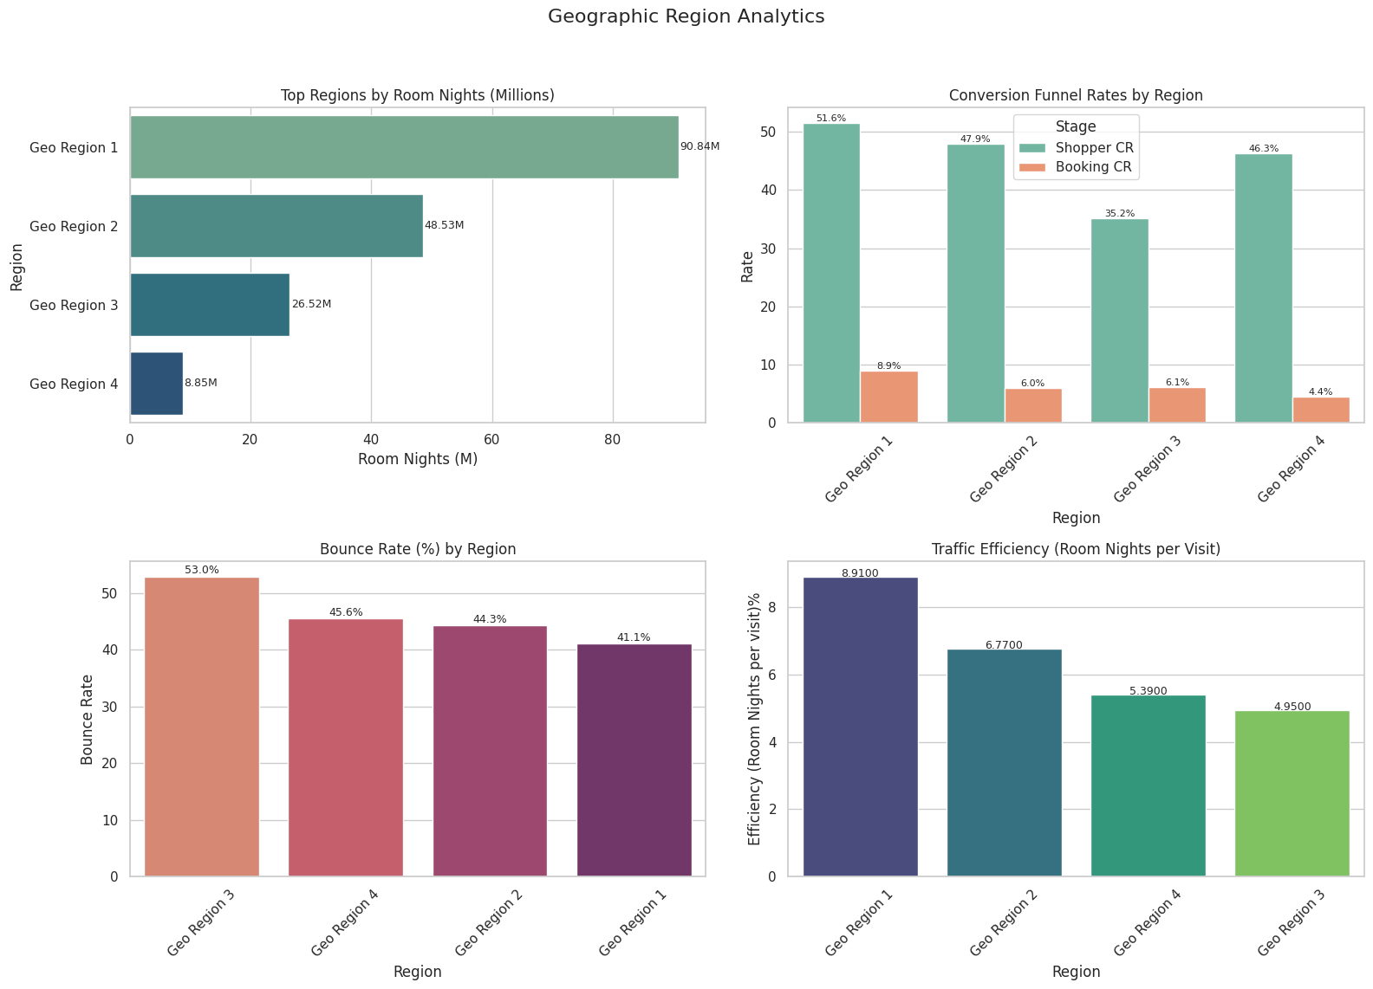
Charts

Slide 17
Geography Region Analysis
1. Room Nights by Region
Geo Region 1 leads by a large margin (90.84M room nights), followed by Region 2 (48.53M).
Region 4 contributes the least (8.85M), indicating lower engagement or traffic volume.
2. Conversion Funnel (Shopper & Booking)
Region 1 has the strongest performance across both:
Shopper Conversion Rate: 51.6%
Booking Conversion Rate: 8.9%
Region 4 shows decent shopper CR (46.3%) but the lowest booking CR (4.4%), suggesting high drop-off post-engagement.
Region 3 has poor funnel metrics — low shopper (35.2%) and booking (6.1%) CRs.
3. Bounce Rate
Region 3 has the highest bounce rate (53%), indicating a mismatch between user expectations and site experience.
Region 1 performs best in minimizing bounce (41.1%).
4. Traffic Efficiency (Room Nights per Visit)
Efficiency follows volume:
Region 1: Highest efficiency at 8.91%
Region 4 and 3 underperform (5.39% and 4.95%)

Slide 18
Recommendation on Geography
Geo Region 1 – Optimize & Scale
Strongest region across all KPIs — continue scaling campaigns and investments.
Consider A/B testing premium offers or loyalty programs here due to high conversion and low bounce.
Geo Region 2 – Improve Booking Conversion
High shopper interest (47.9%) but only 6.0% bookings → optimize post-shopping funnel.
Investigate UX, pricing, or availability frictions preventing booking finalization.
Geo Region 3 – Fix Bounce & Engagement
High bounce (53%) and low conversion → needs major content and targeting revision.
Consider localizing landing pages or retargeting efforts for better relevance.
Geo Region 4 – Improve Booking Completion
Good shopper engagement (46.3%) but 4.4% booking conversion implies friction after interest.
Optimize checkout flows, especially mobile if that’s a factor; consider testing exit-intent offers.

Slide 19
Key Drivers Summary
Channel 2 is the top performer by volume, while Channel 1 delivers the highest booking conversion efficiency.
Peak bookings occur mid-week (Tues–Thurs) and during Q2–Q3, especially in July and October.
Desktop users drive the majority of bookings with nearly 4× higher efficiency than mobile.
Geo Region 1 leads across all KPIs, with the highest room nights, conversion rates, and efficiency.
Mobile platform and Regions 3 & 4 show engagement but low booking conversions — indicating opportunities to optimize UX and targeting.

Slide 20
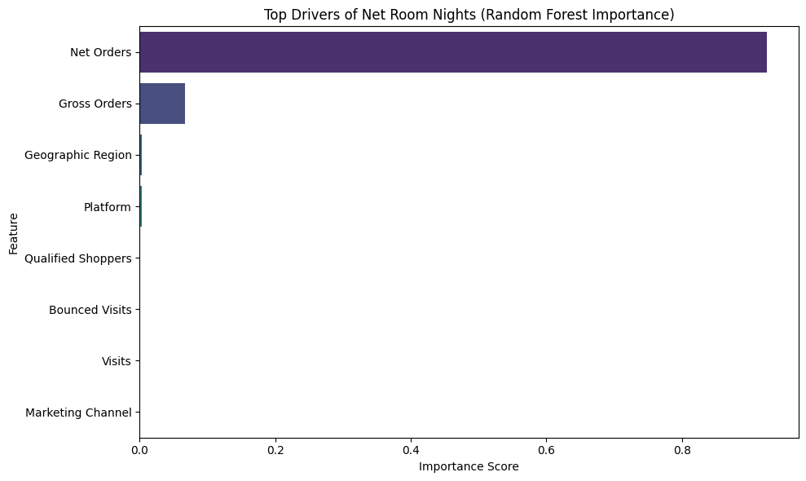
Random Forest Analysis

Slide 21
Random Forest Analysis Insights
Net Orders:
Importance Score: ~0.93
This is by far the most important predictor of Net Room Nights, indicating that the number of net orders (probably bookings that didn’t cancel) has a strong and direct relationship with room nights.
Gross Orders:
Importance Score: ~0.06
This also plays a minor role in predicting Net Room Nights but is significantly less important than Net Orders.
Other Features (Geographic Region, Platform, Qualified Shoppers, etc.):
All have near-zero importance, suggesting they contribute minimally (or not at all) in this model.

Slide 22
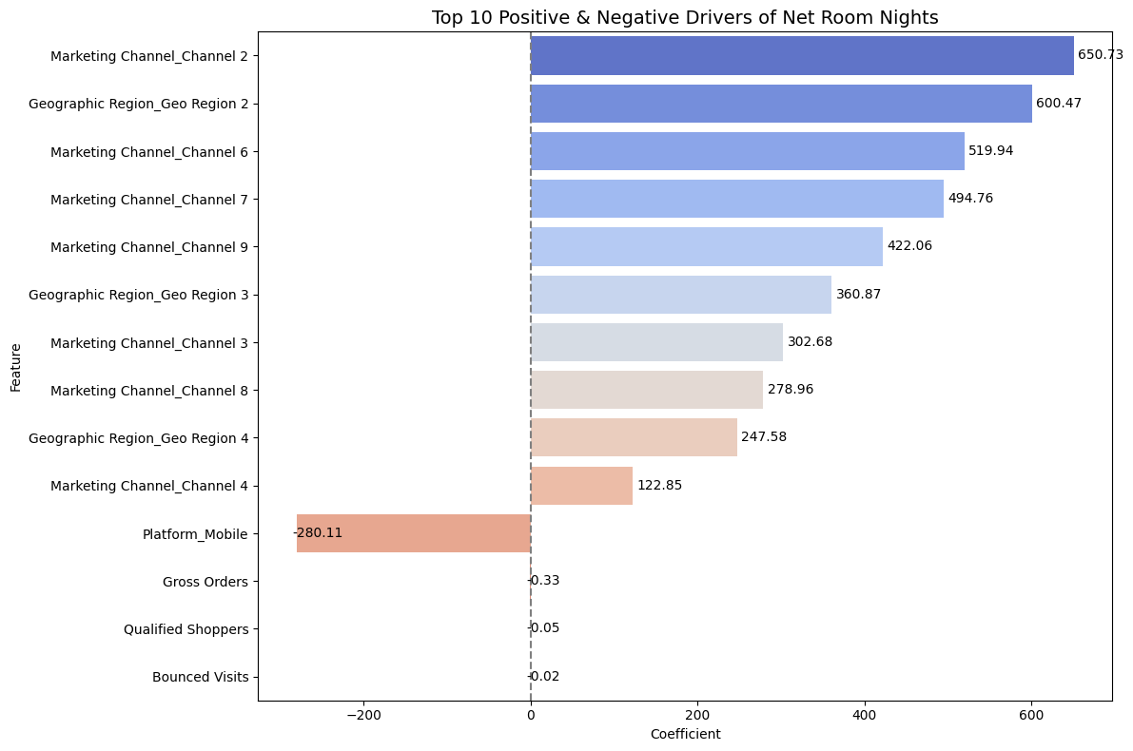
Linear Regression Analysis

Slide 23
Linear Regression Insights
Marketing Channel_Channel 2 is the strongest positive driver of Net Room Nights with a coefficient of +650.73 – prioritize and scale this channel.
Geographic Region_Geo Region 2 contributes significantly with a coefficient of +600.47 – focus marketing and inventory on this region.
Marketing Channel_Channel 6 has a high positive impact (+519.94) – continue investing in this channel.
Marketing Channel_Channel 7 also shows strong performance (+494.76) – maintain or increase support for this channel.
Marketing Channel_Channel 9 adds substantial value (+422.06) – explore what’s driving its effectiveness.
Geographic Region_Geo Region 3 contributes positively (+360.87) – consider increasing visibility and offers in this region.
Marketing Channel_Channel 3 has a moderate positive effect (+302.68) – continue monitoring and optimizing.
Marketing Channel_Channel 8 also helps (+278.96) – ensure it receives adequate attention.
Geographic Region_Geo Region 4 shows a positive impact (+247.58) – potential for further growth.
Marketing Channel_Channel 4 has a smaller but positive influence (+122.85) – assess if it can be improved further.
Platform_Mobile is a negative driver (–280.11) – investigate mobile user experience and conversion issues.
Gross Orders has minimal effect (+0.33) – may not be a direct driver of room nights in this model.
Qualified Shoppers shows negligible impact (+0.05) – reevaluate its effectiveness or measurement.
Bounced Visits has a slightly negative coefficient (–0.02) – as expected, high bounce rates hurt performance.

Slide 24
Linear Regression Recommendations
Focus on Top Marketing Channels Put more money and effort into Channels 2, 6, 7, and 9 – these are driving the most room bookings. Try to find out why Channel 2 works so well – is it the message, the timing, or the type of people it reaches?
Make the Most of Geo Region 2 Geo Region 2 is performing really well – target it with special campaigns, offers, and localized content. Think about what kind of deals or ads work best in this region and use more of those.
Fix Mobile Platform Issues Mobile users seem to be booking fewer rooms. Check the mobile site or app for problems like slow loading, confusing layout, or bugs. Try A/B testing mobile improvements or run special mobile-only deals.
Spend Less Time on Low-Impact Features Some features like Gross Orders, Qualified Shoppers, and Bounced Visits don’t really affect bookings in this model. You can spend less effort tracking or optimizing these – they may not be worth it right now.

Slide 25
Summary Recommendations
Scale investments in high-performing channels (esp. Channel 1) with strong ROI.
Audit low-performing channels: Consider refining messaging or pausing underperformers.
Use A/B testing for ads or landing pages tied to Channels 4, 6, and 9.
Optimize the mobile experience: Consider faster loading, better search UX, and streamlined checkout.
Consider device-targeted promotions or incentives for mobile to close the performance gap.
Investigate session duration and bounce rates by platform to identify drop-off points.
Encourage longer stays on mobile bookings with targeted upsells.
Schedule campaign pushes Tue–Thu to align with peak engagement.
Boost Q4 performance with holiday bundles or loyalty rewards.
Use slower periods (e.g., Sunday) for site maintenance or experiments.

Slide 26

Thank You / Q&A

